Slide 1
Leadership Portfolio
Schuyler Vizcarra

Slide 2
Biography
Schuyler Vizcarra was born and raised in Las Cruces, New Mexico. Schuyler attended Mayfield High school and graduated in the spring of 2007. Following her graduation, she began her college education at New Mexico State University. Schuyler is a CMI major and hopes to have a successful career in the film industry. She plans to graduate in the fall of 2011.
Schuyler has involved herself with volunteer opportunities and organizations throughout her educational career. She previously volunteered for the Housing Authority of Las Cruces. Schuyler has helped tutor low income youths and families. She has volunteered with the Housing Authority to help prohibit the use of tobacco products in area restaurants. She has also volunteered for Special Olympics in the state of New Mexico, helping coordinate area track games. Other volunteer work includes working as a precinct coordinator in 2008 for state Senator Mary Jane M. Garcia.
During her high school education, Schuyler involved herself with organizations that provided furthering Leadership skills. Schuyler was a member of MESA, Math, Engineering, & Science Achievement. The MESA organization helps disadvantaged students excel at math and science. Schuyler was also a member and vice president of FCCLA, Family Career Consumer Leaders of America. This organization provides students with leadership growth and opportunities.
Schuyler has developed leadership skills during her previous jobs. In the spring of 2006, Schuyler worked at Schumacher’s Veterinary Clinic of Las Cruces. Here Schuyler built teamwork skills, working with the doctors and employers to treat and care for the animals. Schuyler worked as a librarian at Dona Ana Community College in 2008-2009. Schuyler learned to recognize needs of customers. The job also helped manage her organizational skills. These were needed to keep the library running smoothly. Schuyler presently works at the New Mexico State Tennis Center. Some of the duties include dealing with patrons and managing the tennis Lobby.
Schuyler’s PLSI score, INFJ, reflects her leadership traits. Schuyler genuinely enjoys helping and leading others. Schuyler has learned what traits are needed further her leadership skills. She plans to use her knowledge to better her education career, and film career.

Slide 3
PLSI Score
I am an INFJ, the "counselor."
Characteristics of INFJ:
Making decisions easily
Understanding complex issues
Being aware of other people's feelings.
I can relate to INFJ because I am a reserved person. However, I work well with others accomplishing what needs to be done.

Slide 4
Challenge of Leadership
What makes a good leader? Most would agree that a leader must exhibit the following traits: visionary, orderly, and honest. However, when does one become a leader? Are these visionaries born, or are they made? After reading and viewing the following material, I feel that leaders are made. These leaders see a vision and dedicate their lives to make a change. With this, they gain the trust of others, and people follow in their vision. It is in this, that leaders are made. Inspiration is the true key to leadership.
Chapter three discusses the qualities many leaders have all shared; they all were passionate about their causes. People trust those who follow through with their ideas and passions. A person, who sticks up for what they believe in, sets a good example of leadership. However, there is a catch. This leader must exhibit knowledge of their beliefs. A cause is not worth fighting for, if you don’t know why you’re fighting for it. If the leaders are honest, people will follow.
Chapter four, contests the importance of setting an example. For those working to becoming leaders, they must work hard and set an example for their peers. Chapter four explains that a leader must “personify the shared values and teach others to model the values.” This means a leader must personally evaluate the vision. They must do what needs to be done first, before they show others. One who fulfills the needs of a vision and shows others the way, will be a successful leader. You cannot simply inspire people, when no example is shown first.

Slide 5
Challenge of Leadership Cont.
In the article Futuristic Leadership in a Global Community, new ideas of leadership are evaluated. The article discusses leadership among schools. The administrators of the schools are using old ways of thinking when it comes to leadership. Because each school differs, there is a concern that “normal” leadership training among schools is not enough. The principal, who runs a school, is looked at as the leader. The principal is assigned to make decisions for the school on behalf of the school. However, as argued in the article, new ideas of leadership should be considered. Uniting the school, as a team, to make decisions would be more beneficial. As mentioned in the article, this would influence a “shared vision.” In the article, the idea of the team being as one, results in a stronger result.
Both videos examine the role a leader plays. Video one asks the question, “Are leaders born, or made?” In the video examples like Gandhi and Bill Gates are shown. Both, sons of lawyers, grew up to be influential leaders looked at globally today. Instead of following in the footsteps of their fathers, they set on ventures of their own. They each had a vision of their own, and through that, changed the world. This shows how leaders are made. Video two’s clip explains the importance of leadership. The commander tells this captain of the importance he plays among his men. This captain must be set the example for his men to follow, even in times of hardship. Through this example, he will lead.
There are many leaders and visionaries I look up to today. One that I find to be inspirational to me is Eva Peron (Evita). When she was young, she had goals of becoming an actress. It wasn’t until her marriage that she became involved with the government of Argentina. It was then that she created a vision; a vision to fight for labor rights of workers and fight for woman’s suffrage. She influenced a nation, and through that, helped the labor workers and influenced woman’s’ rights. It is through people like her, that leaders are made.

Slide 6
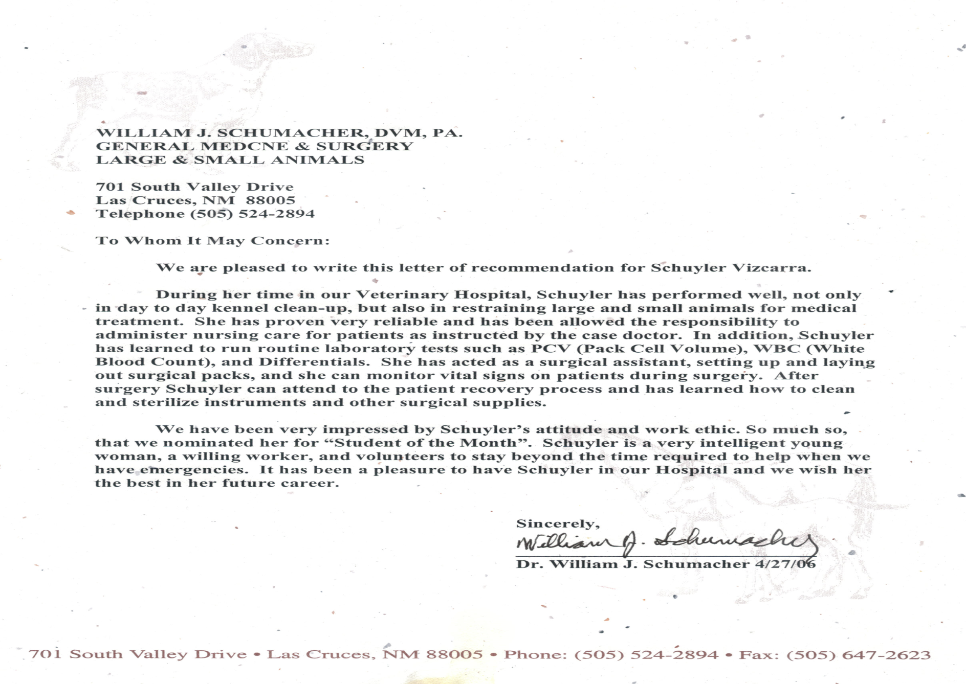
Accomplishments

Slide 7
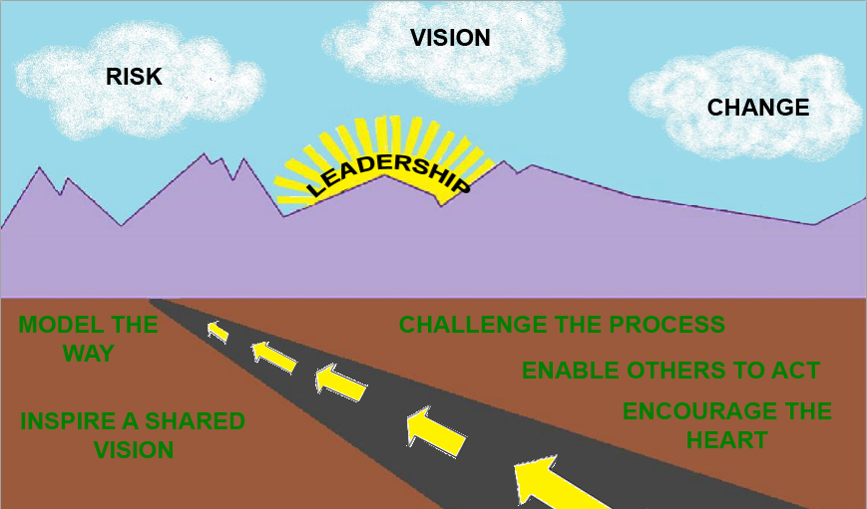
MY VISION

